Slide 1
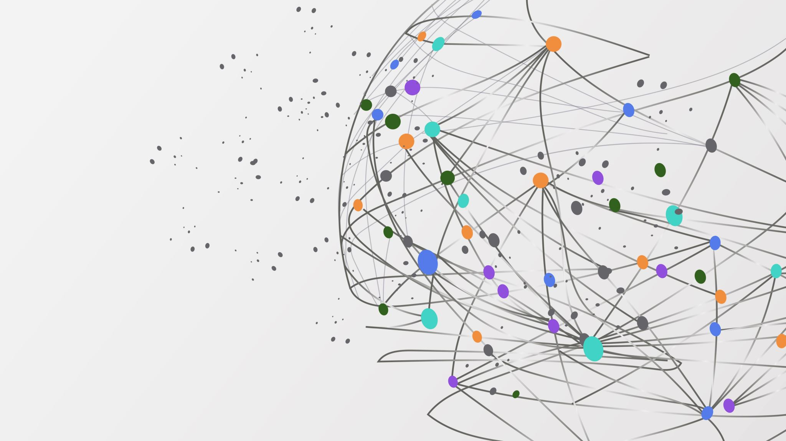
Exploring Quantum Neural Networks (QNNs)
A Deep Dive into their Potential, Challenges, and Future
Andrew Nerud
CSCI 373 Senior Research Seminar

Slide 2
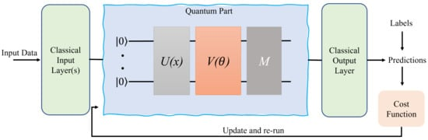
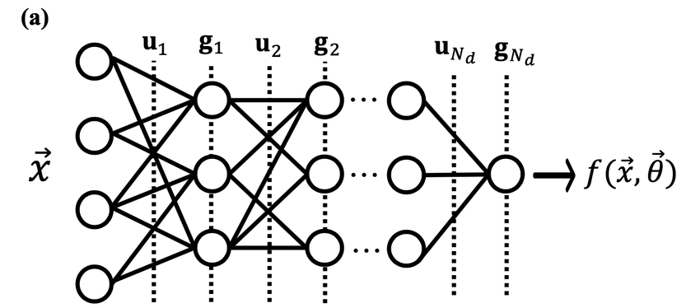
What if Machine Learning Could Go Quantum?
Quantum Neural Network
vs.
Classic Neural Network

Slide 3
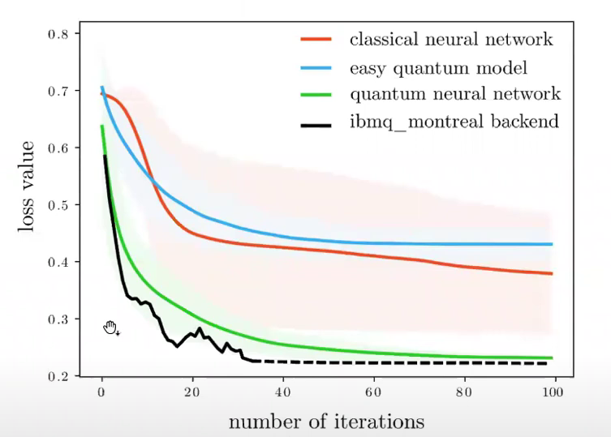
Why Do QNNs Matter?
Possible Research Focuses
Issues
Barren Plateaus
Hardware Limitations
Applications
QNN Architectures
Training Methods
Computational Efficiency
Could They Outperform CNNs?
Fig 1. Amira Abbas. (2020, Dec 7). Are quantum neural networks actually relevant? [Video]. https://www.youtube.com/watch?v=aU8XBjG5tAw

